Slide 1
Snake Game

Slide 2
Hello!
presented by :
I.Lakshmi Priyanka
(9920004507)
A.Meghana Reddy
(9920004561)
IIND-Year
cse -B section

Slide 3
snake gaame’s histroy
Snake is an older classic video game. It was first created in late 70s. Later it was brought to PCs. In this game the player controls a snake. The objective is to eat as many balls as possible. Each time the snake eats an ball its body grows. The snake must avoid the walls and its own body. This game is sometimes called Nibbles.

Slide 4
So lets get this straight, What do we need in our snake game?
A snake? Ofcourse!
Food for the snake!
A board.. where will the snake move afterall
Logic for the real game

Slide 5
Steps that are done in this game
Game
This is the meaty part of the code
Board
where will the snake move afterall
Cell
food for the sanke
Snake
main part of the game

Slide 6
Step - 1
A function to grow the size of the snake.
A function for the snake to move.
A function to check if the snake has crashed.
A function that returns the snake
A function to set values in the snake.
A function that returns the head of the snake.
A function to set the head of the snake.
Snake
A Snake Class for the snake. We want to
Know and maintain the size
.
The ability to control movement of the Snake
Check whether it did not hit a Wall.
So it shall contain the following functions:
A constructor to initialise the snake with its head.

Slide 7
Cell
Our boards, consistes of various cells, A cell at random will be proclaimed as the cell containing food. The identify of food is random, but identity of cell is meaningful, so I would rather make a class Cell than food.
Cells are also important to kep track of position of the snake!
Each cell is thereby contains the information about
Its Row
Its Column
Whether it contains food or not?
Whether it is a part of the snake or not?
Hence its member functions include
A constructor to initialise it.
A function that specifies its type (contains food etc.)
A function that returns its type.
A function to return its row.
A function to return its column.

Slide 8
Step - 3
It will contain the following functions
A constructor to initialise te board with number of rows and columns.
A function to return its cells.
A function to set values in its cells.
A function to generate Food.
Board
It is the set of valid points for the game to function on, qualitatively a matrix of cells.
While the cells revert to the questions, being the collection and home of cells, the board needs to ensure the cells get satisfiable answers

Slide 9
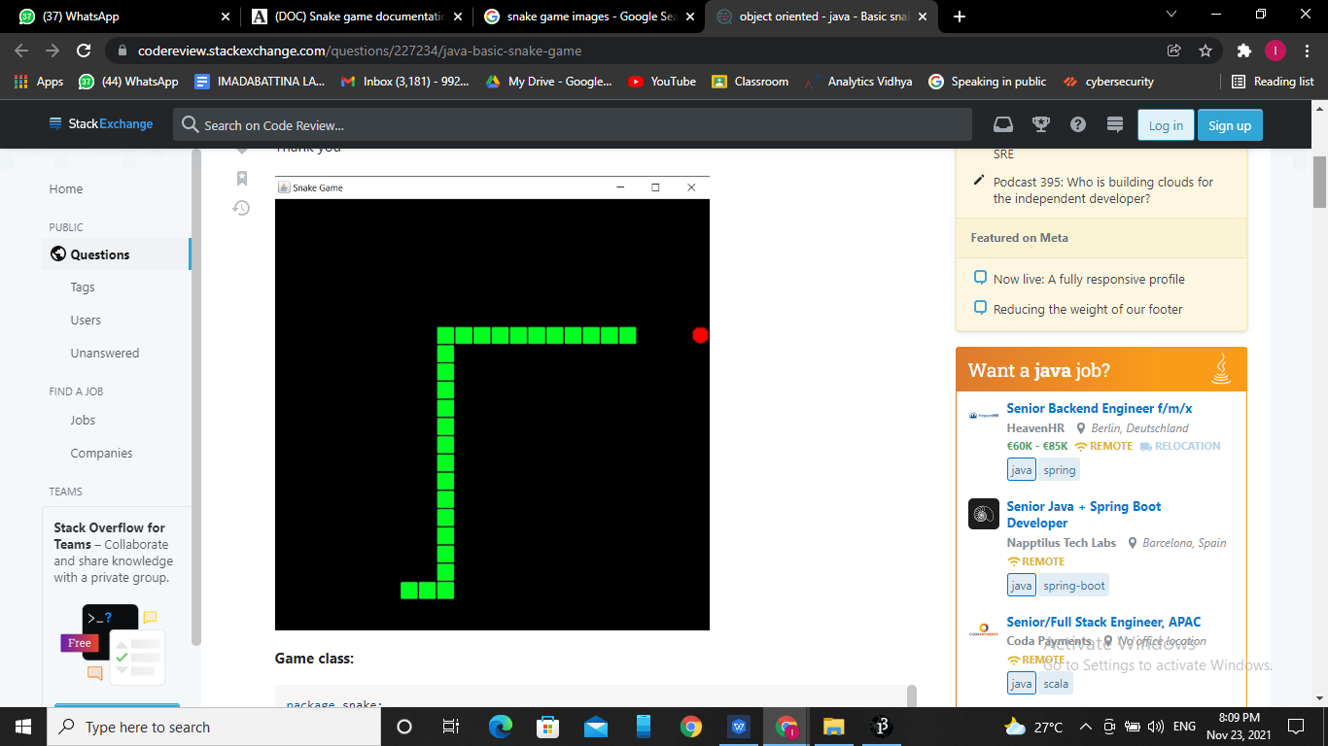
Game
This is the meaty part of the code, our primary logic, the game!
It needs an instance of
Board
Game
Notice how Board already contains instances of Cell.
This also needs to contain the following
Ability and logic to use the classes we make and conduct a game!
Know when the game is over

Slide 10
So the following functions will be required:
A constructor to initialise the game with a snake and a board.
A function to return the snake.
A function to set the value of snake.
A function to return the board.
A function to set the value of board
A function to set the game to be over.
A function to check if the game is over.
A function to set the direction of snake's motion.
A function to return the direction of snake's motion.
A function to update the game according to snake's movement.
A function to keep track of the forthcoming cell.
After this we will also define a main function to
actually play the game.

Slide 11
Conclusion
This project gives us more thrilling ,frustrating and aslo gives us more pleasure .it helps us in many sectors like planning,designing,develpoing , managing,programming skills ,socket programming and so on.

Slide 12
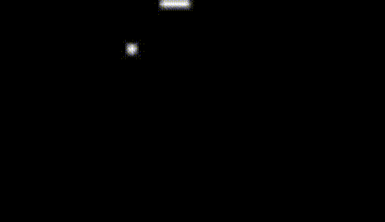
Thank You

